Slide 1

Classroom scheduler
Presented By:
1. Shubham More
2. Sameer Dhumal
3. Milind Kondekar
4. Gaurav Hadge
5. Rushikesh Kadam
6. Prachi Rathod

Slide 2
Project Description:
Classroom-Scheduler is a free blended learning platform for educational institutions that aims to simplify creating and distributing timetable.
It is a web based application where Multiple Class-Coordinator can create their own classroom by adding teachers , students , subjects and timetables.
Teacher can view their specific slot of timetable of their own.
The primary purpose of Classroom-Scheduler is to streamline the process of sharing timetable between teachers and students.
Classroom-Scheduler helps in centralizing data of students and teachers.

Slide 3
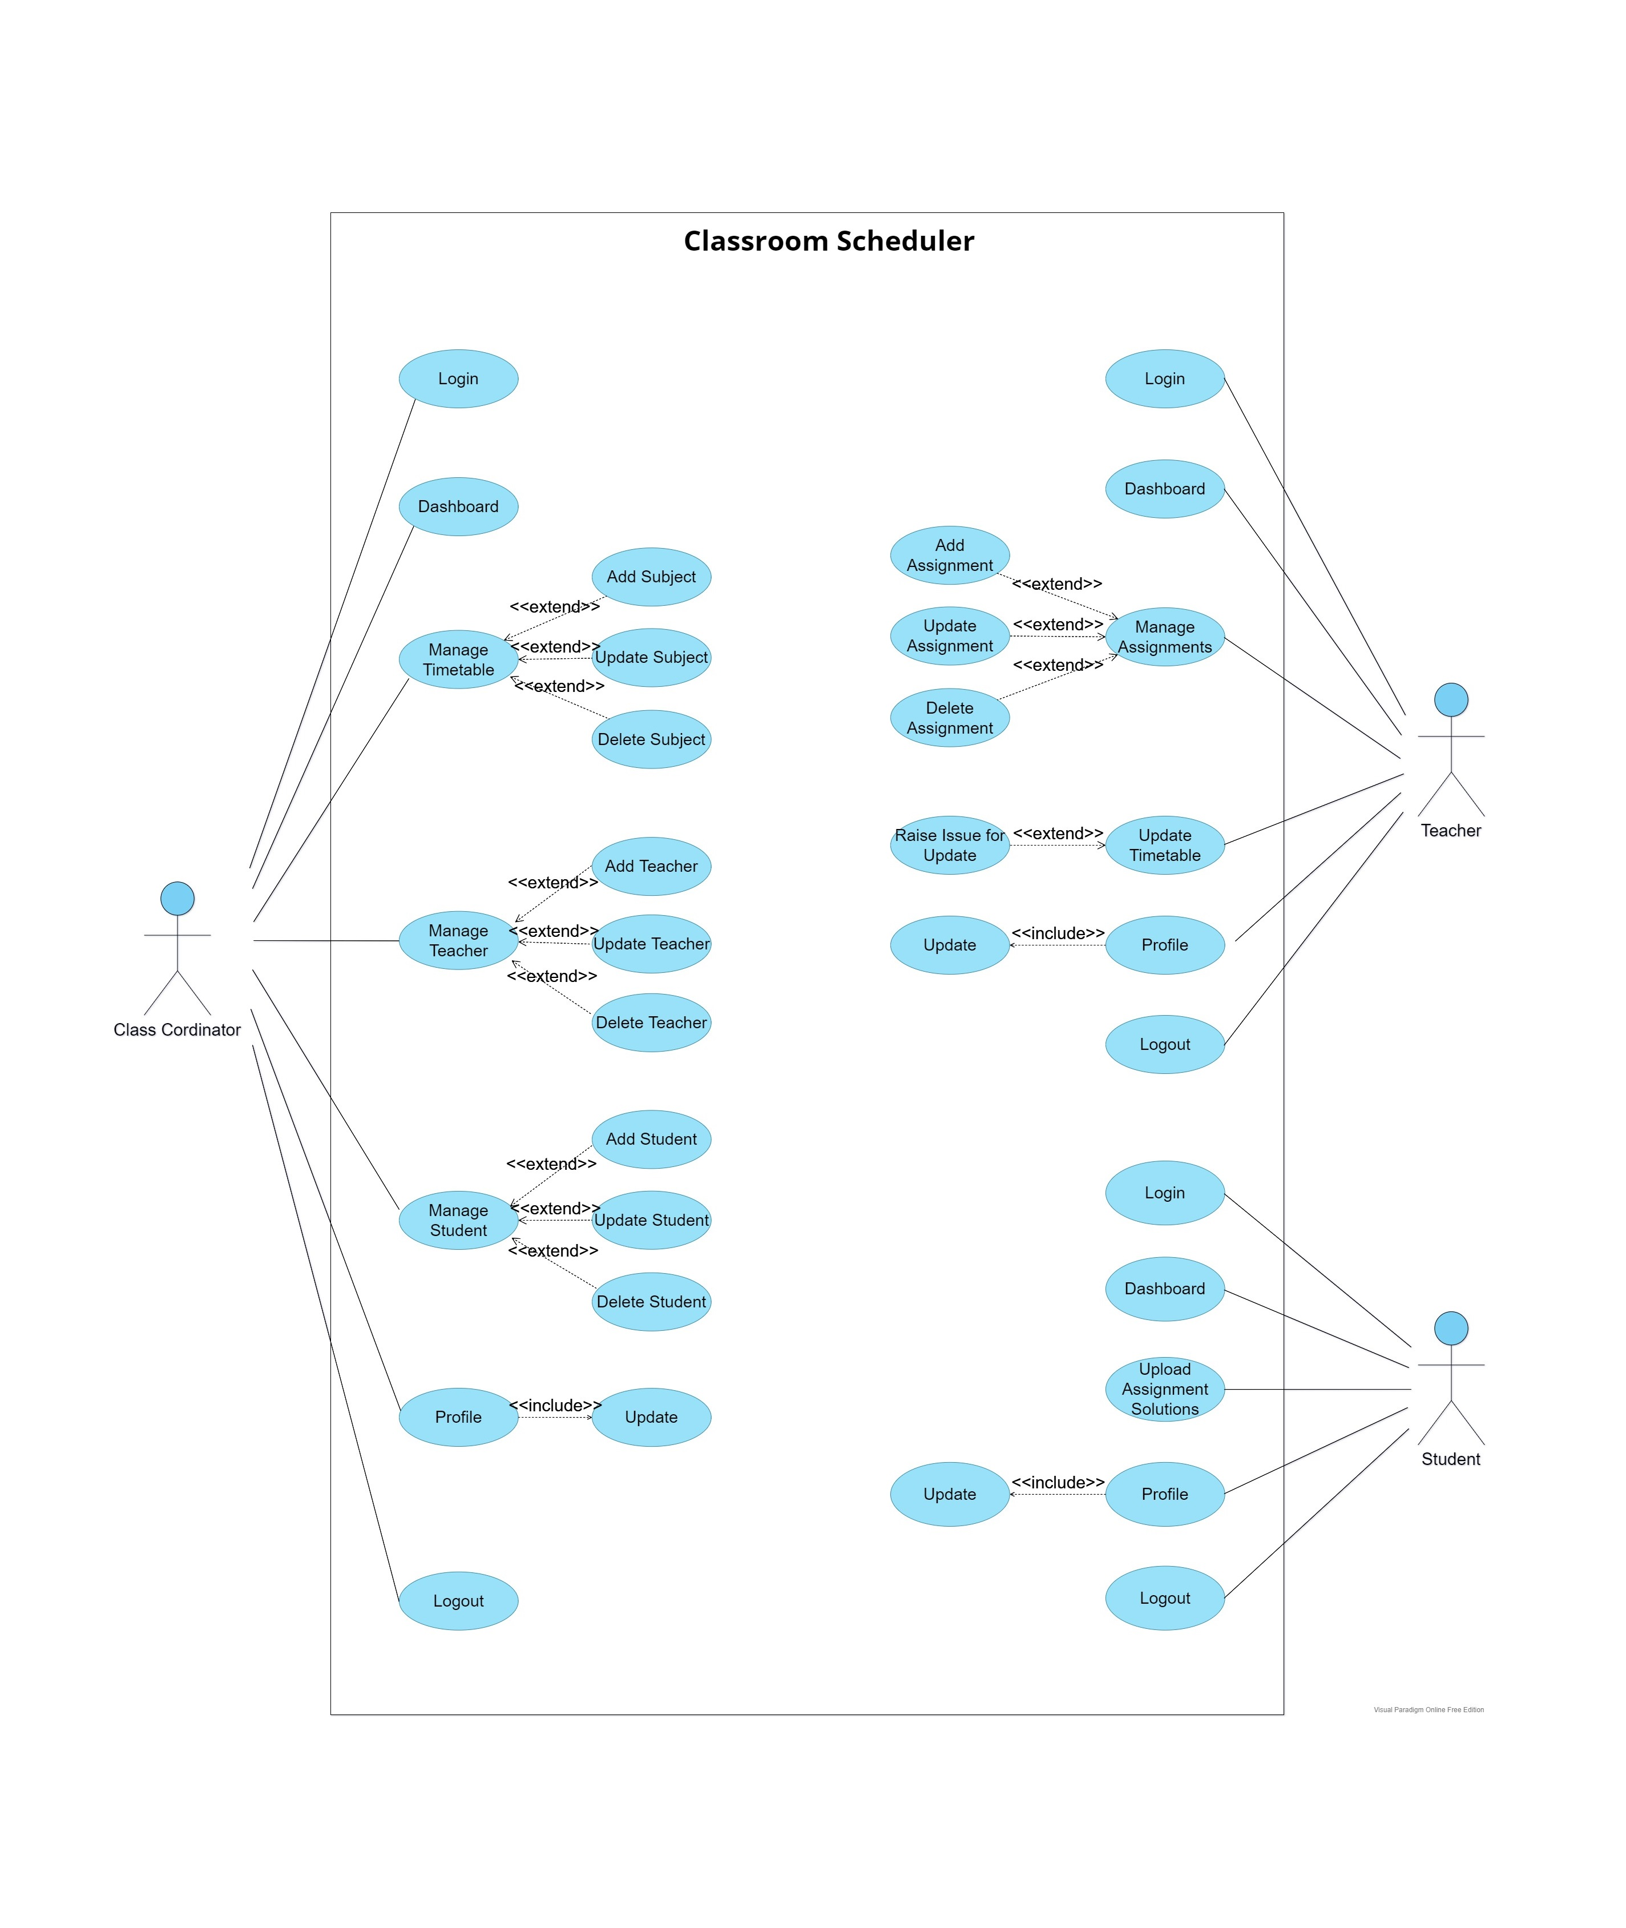
Use Case Diagram :

Slide 4
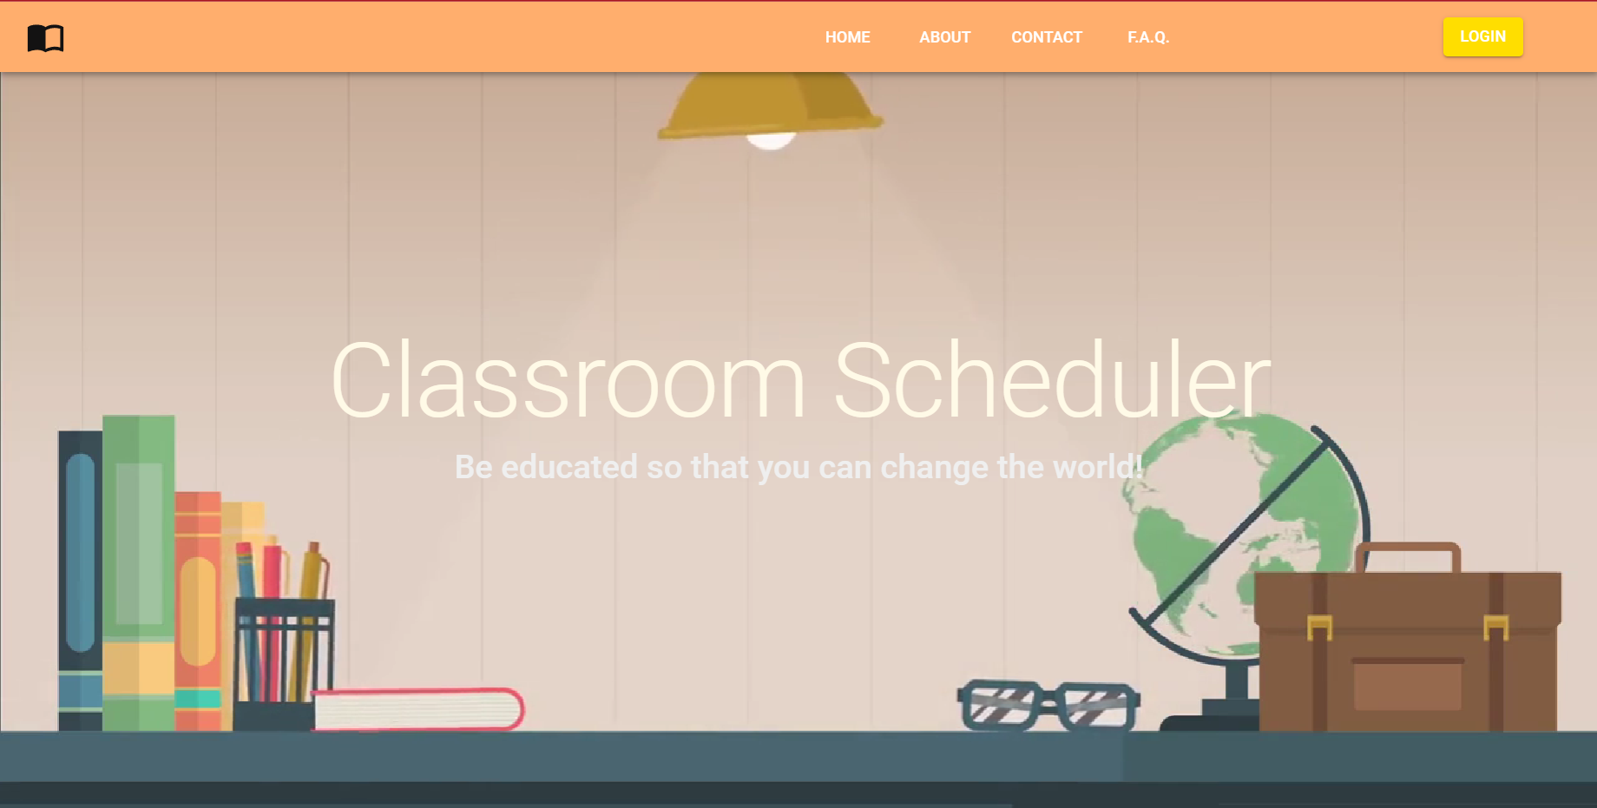
Landing Page:

Slide 5
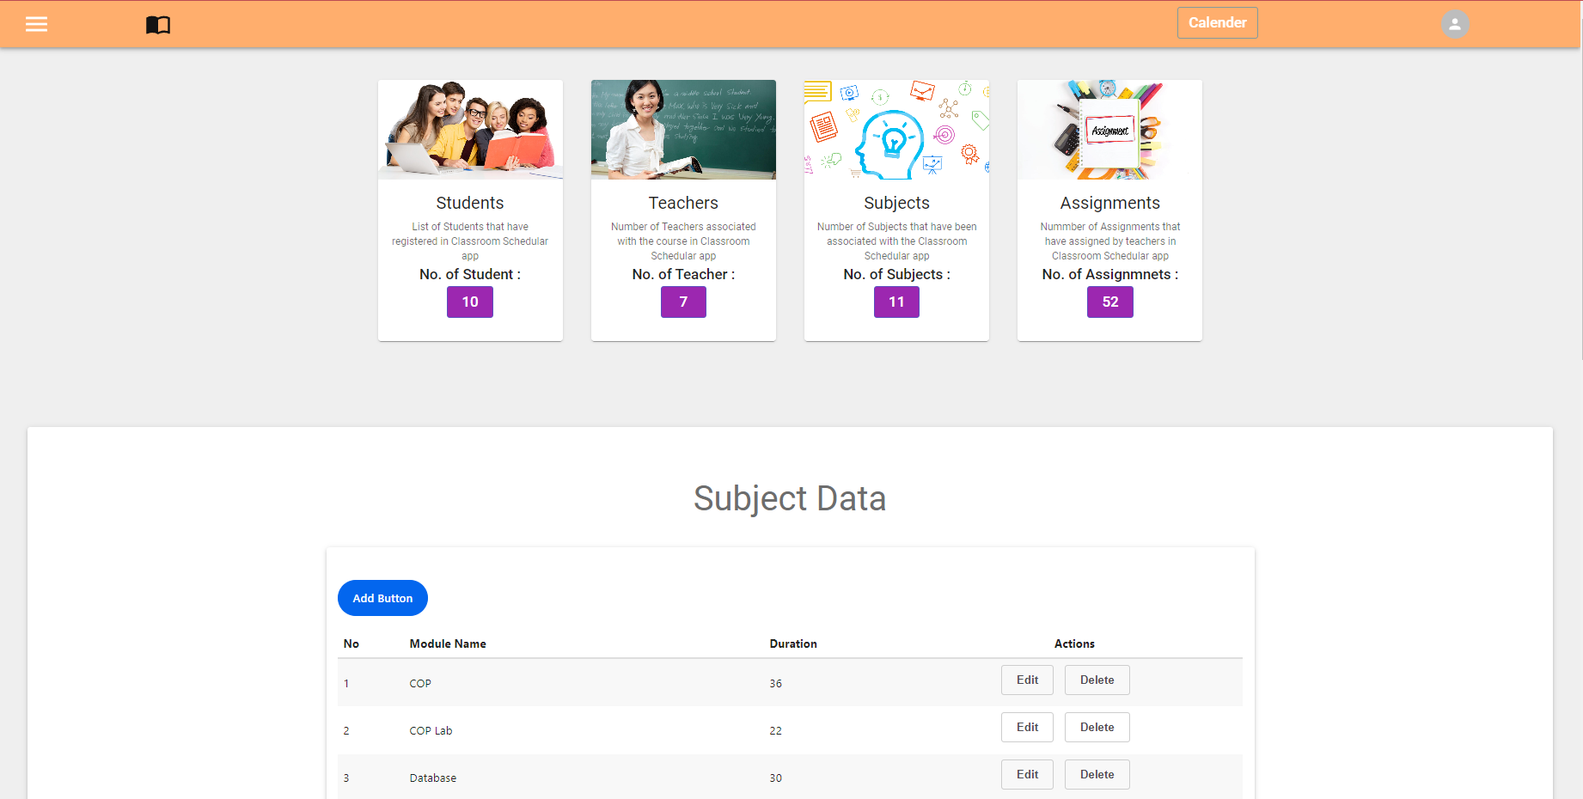
Admin Dashboard:

Slide 6
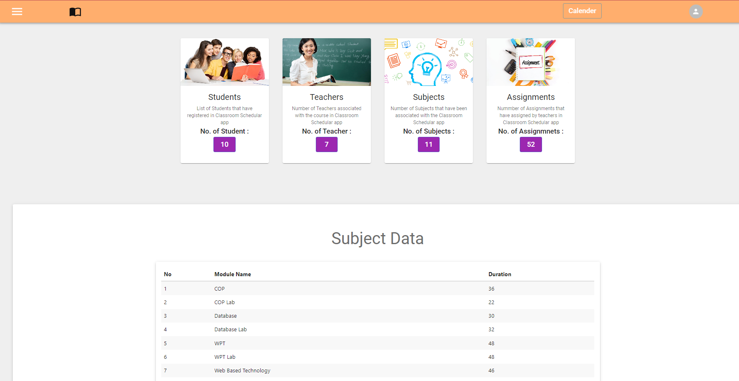
Teacher Dashboard:

Slide 7
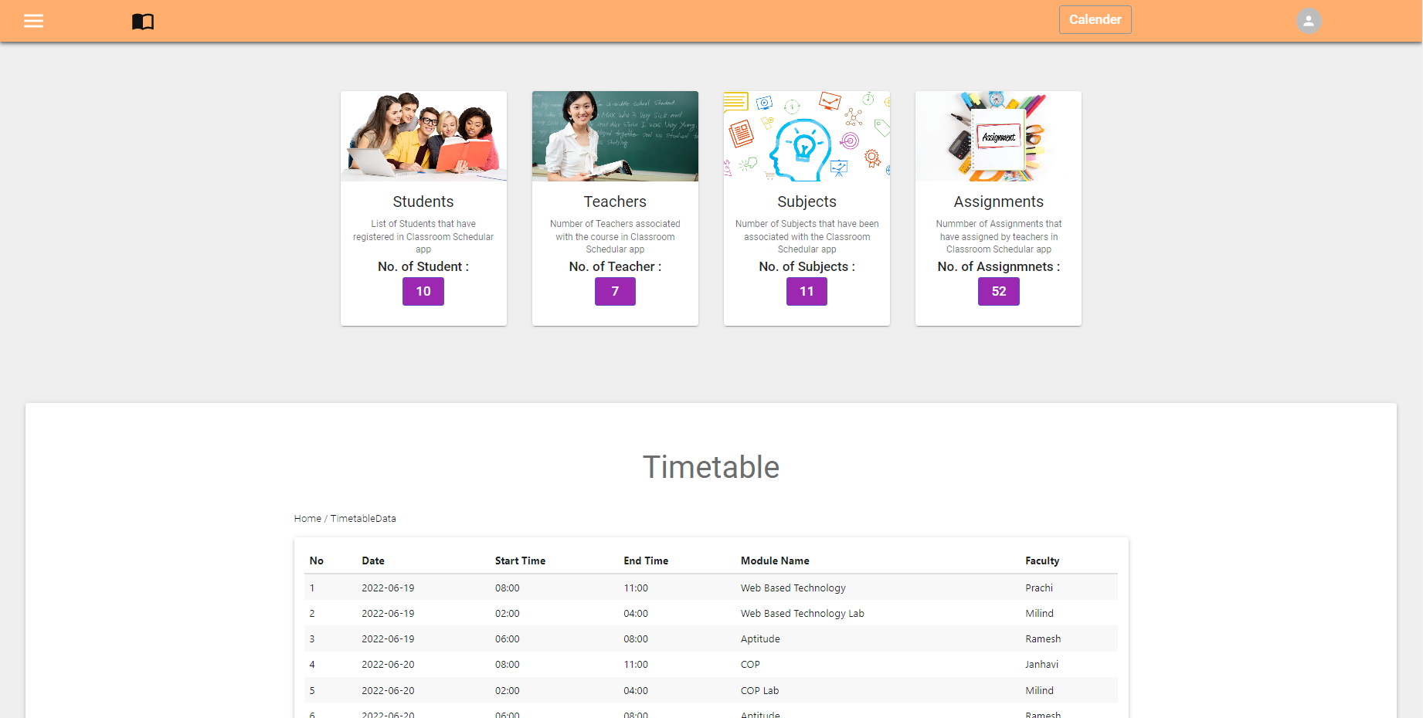
Student Dashboard:

Slide 8
Thank You !!!

